Slide 1
Help Nature, Change Yourself!

Slide 2
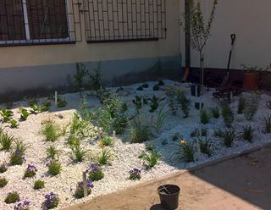
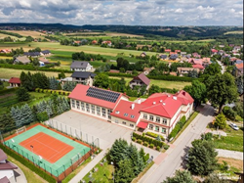
Sun Panels
Catch the rain
There are sun Panels on the roof of our school.
They can give more electricity.
In our school we have the rain garden.
Rain water is used to water all plants.

Slide 3
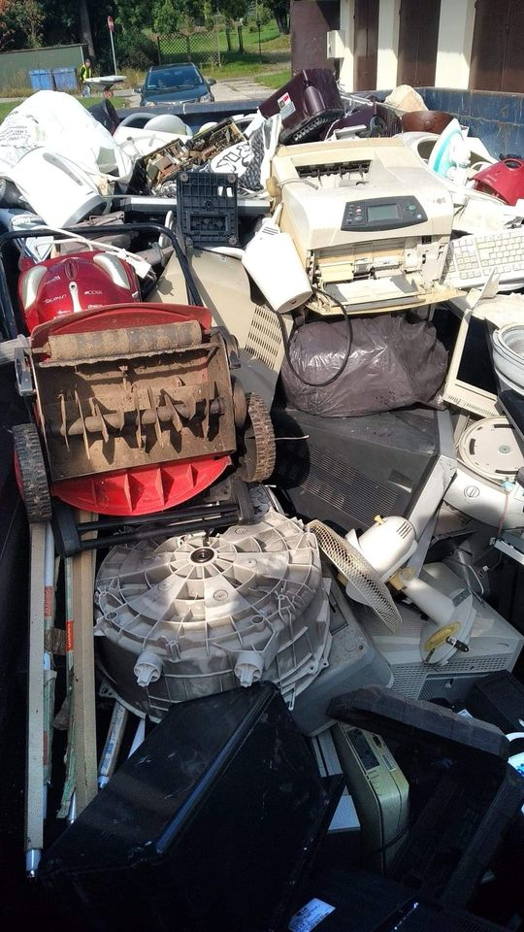
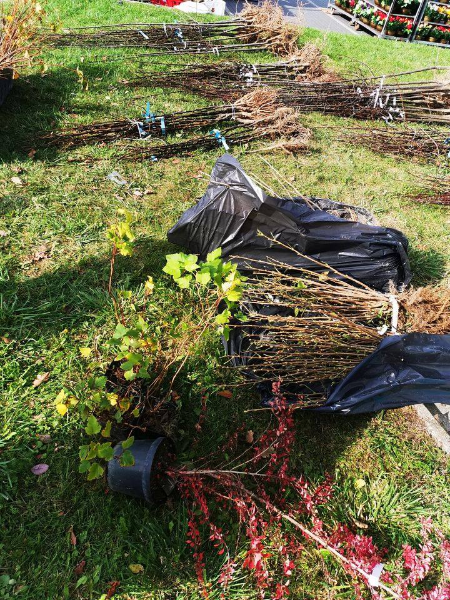
Clean our community action
Ecological picnics
You can take your old TV or computer there and get a palnt in return.
Everyone can help in this action.
Citisens of our community can clean a forest or a playground in own village.

Slide 4
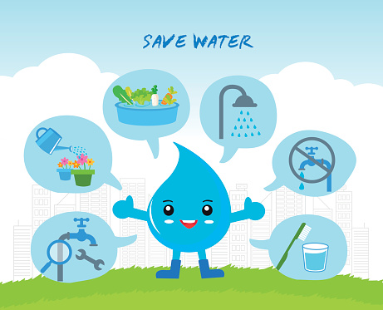
How can you help nature at home?
Turn off the light in the room, when you don’t need it.
Segregate rubbish.
Turn off the water, when you don’t use it.

Slide 5
Clean air
Parents can replace the old heating stove with a new one. When everybody do the same, the air is cleaner.

Slide 6
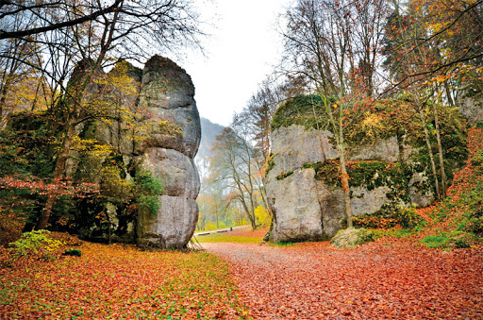
Visit us!
We should take care of nature, beacuse we live in beautifull place near the National Park in Ojców. You can see there: Kraków Gate Hand Rock and Łokietek’s Cave.

Slide 7
Thanks for your attention!
Author: Dorota Karłowska

